Slide 1

Assignment 4
Justin MacDonald
Notes:
Pitch it and have fun Bring the energy Goal is to be someone else
This is a project I think I can do and I believe I can lead a team through this.
Be Honest

Slide 2
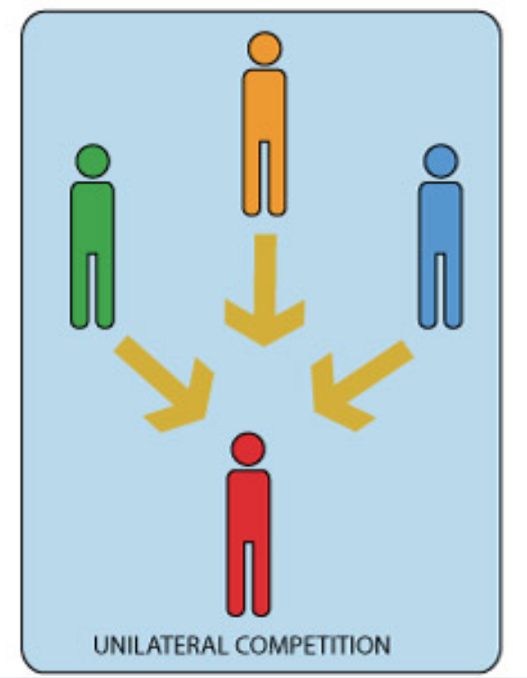
Players
Unilateral Competition
Examples
Tag
Scotland Yard
Dodgeball

Slide 3


Concept
One player is a thief and everyone else is a detective

Slide 4
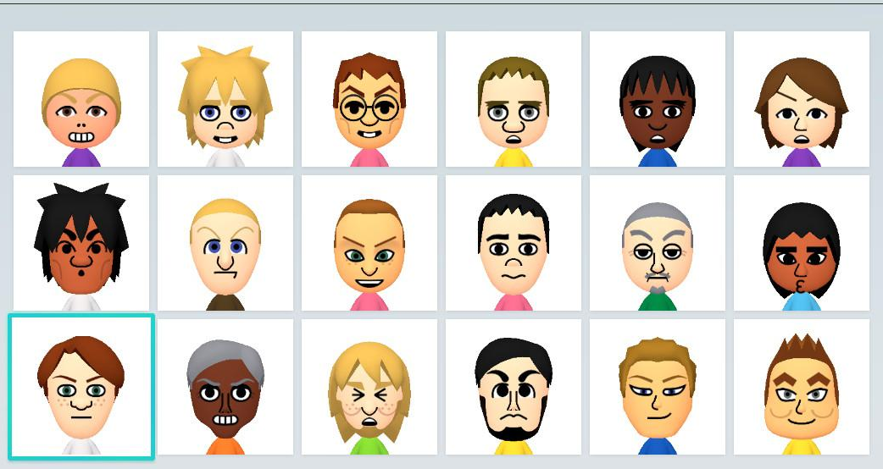
Concept
The thief will choose a civilian to play as.
Notes:
Mention civilians will be randomly generated

Slide 5

Concept
The detectives will attempt catch the thief commiting a crime.

Slide 6


Concept

Slide 7

Concept
A game will last under 5 minutes or until the thief finished commiting a crime. Each detective will cast one vote

Slide 8
Concept
Then the thief is revealed, ending the game.

Slide 9
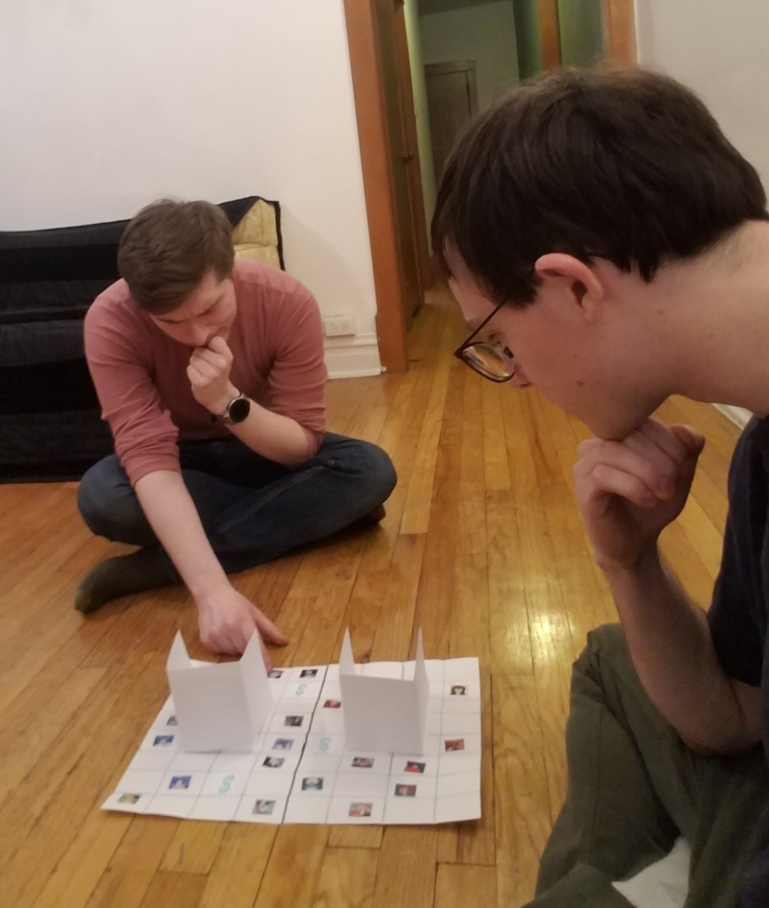
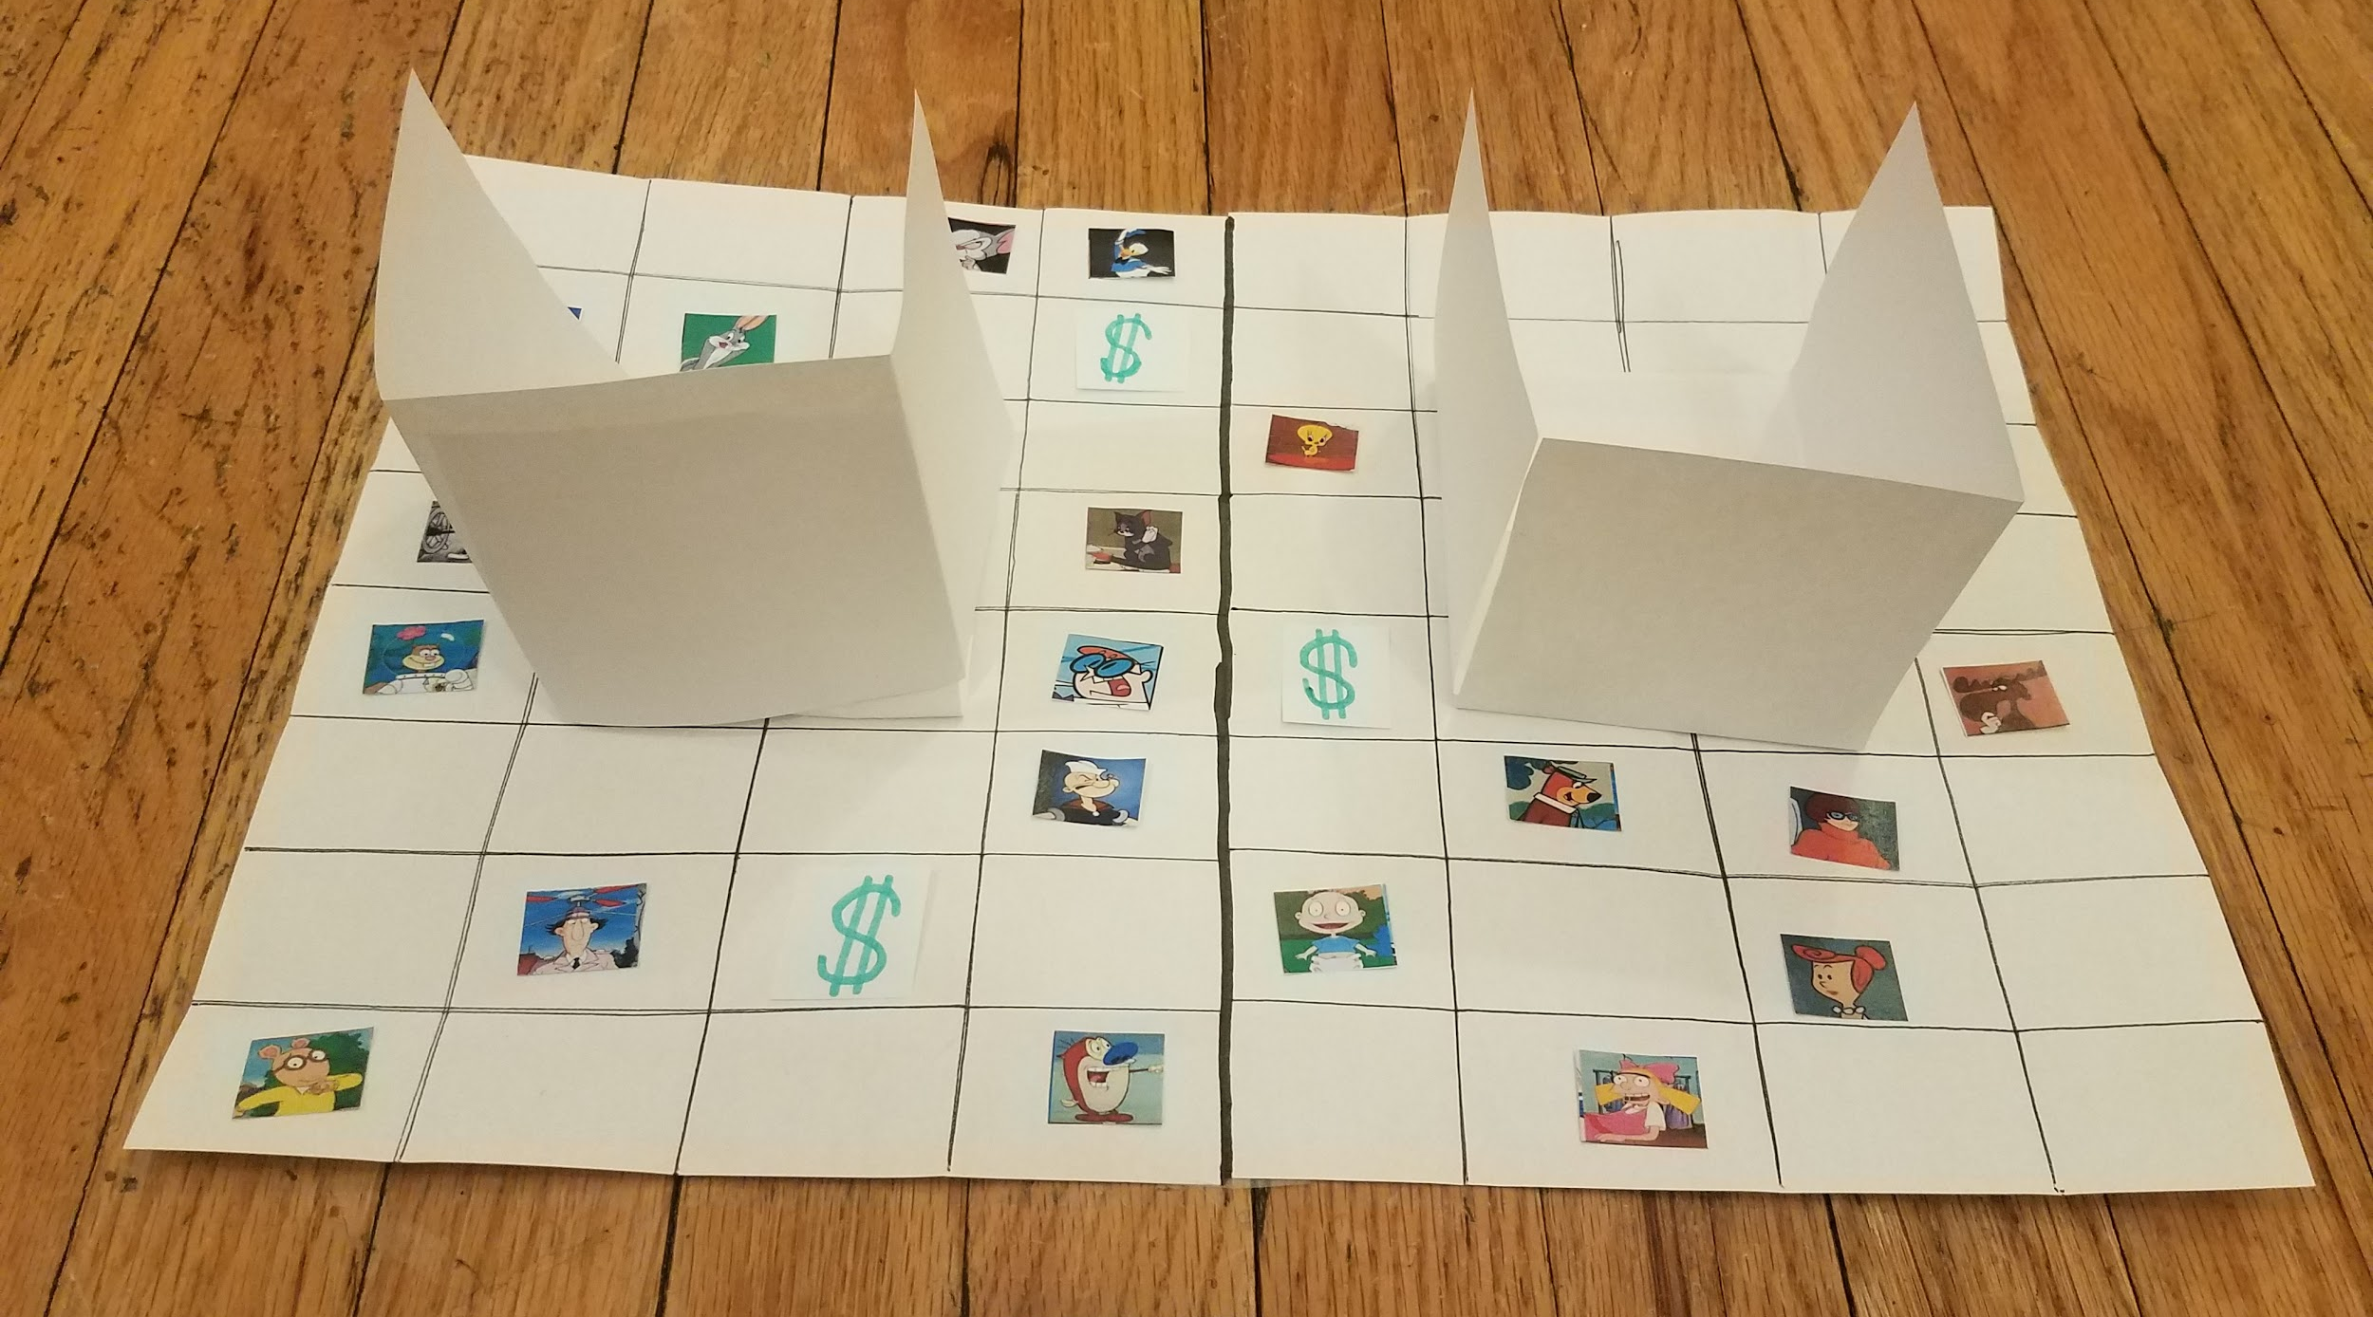
Prototype
The criminal player chooses a main character at the start of the game. And are allowed to move any other character to throw off the detective.
Cash can be grabbed as long as the criminal's character is in front of it. The detective only gets one chance to guess the criminal.

Slide 10
Team Members Interested In...
Code
Pathfinding
Random Character Generation
Simple UI
Art
Low poly model
Animation
Facial features
Sound

Slide 11
Formal Elements of a Game
Players
Objectives
Can be played a minimum of 2 and a maximum of the capacity of the cave. 1 player is the criminal while the other players are detectives. It is both a compete and cooperate game. Therefore, it is a unilateral competition game.
Catch the criminal or successfully commit a crime undetected
Type of Objective: Capture and Chase

Slide 12
Formal Elements of a Game
Procedures
Rules
Detectives
No controls. They just cast their vote
Thief
Move: Control
Action: A Button
No screen peeking!

Slide 13
Formal Elements of a Game
Resources
Conflict
Number of allowed votes. For example, the whole detective groups gets only 3 votes to use as a collective. There’s a time limit to commit a crime.
The criminal is the source of conflict for the detectives. Vice Versa.

Slide 14
Formal Elements of a Game
Boundaries
Outcome
The thief cannot go outside the detectives prospective. Otherwise, he’ll never get caught.
Either the detectives win or the criminal wins

